Slide 1
VCU HUMAN RESOURCES PRESENTS:
HOW TO RETIRE WITH THE
VIRGINIA RETIREMENT SYSTEM
Last Updated: 02/18/2024

Slide 2
OBJECTIVES & AGENDA
Retirement Eligibility
Calculating Retirement Benefits
Payout Options
Retiree Healthcare & Life Insurance
Leave Payouts & Reemployment
*

Slide 3
ABOUT THE DEFINED BENEFIT PLAN
VRS Plan 1 & 2, VaLORS, and Hybrid (Defined Benefit)
A guaranteed lifetime monthly retirement benefit
Based on a formula
Not based on contributions
*

Slide 4
RETIREMENT ELIGIBILITY
VRS PLAN 1
(You are in VRS Plan 1 if your membership date is before July 1, 2010, and you were vested as of January 1, 2013)
EARLY RETIREMENT
Reduced Retirement benefits
Age 50 with at least 10 years of service, or
Age 55 with at least 5 years of service
FULL RETIREMENT
Unreduced Retirement benefits
Age 65 with at least 5 years of service, or
Age 50 with at least 30 years of service
*

Slide 5
RETIREMENT ELIGIBILITY
VRS PLAN 2 & HYBRID
Plan 2: Membership date prior to July 1, 2010 but not vested as of January 1, 2013 or
membership date between July 1, 2010 and December 31, 2013 with no prior VRS service credit.
Hybrid: Membership date on or after January 1, 2014
EARLY RETIREMENT
Reduced Retirement benefits
Age 60 with at least 5 years of service
FULL RETIREMENT
Unreduced Retirement benefits
Your normal Social Security retirement age with at least 5 years of service, or
When sum of age and service equals 90
*

Slide 6
CALCULATING THE UNREDUCED BENEFIT - VRS
 | Plan 1 | Plan 2 | Hybrid DB
Average Final Compensation | Highest 36 months of consecutive salary | Highest 60 months of consecutive salary | Highest 60 months of consecutive salary
Retirement Multiplier | X1.7% | X1.65% | X1.00%
Years of VRS Service credit | X Years of Service Credit | X Years of Service Credit | X Years of Service Credit
Yearly Benefit Amount | Annual Benefit Amount | Annual Benefit Amount | Annual Benefit Amount
Number of Months | ÷ 12 Months | ÷ 12 Months | ÷ 12 Months
Monthly Benefit (before taxes and other deductions) | Monthly Benefit Amount | Monthly Benefit Amount | Monthly Benefit Amount
If you retire with a reduced benefit, VRS will first determine the amount of your Basic Benefit and then apply an early retirement reduction factor.
*

Slide 7
RETIREMENT ELIGIBILITY
VRS VALORS PLAN 1 & 2
(Must be a sworn Campus Police Officer)
EARLY RETIREMENT
Reduced Retirement benefits
Age 50 with at least 5 years of service
FULL RETIREMENT
Unreduced Retirement benefits
Age 60 with at least 5 years of service, or
Age 50 with at least 25 years of service
*

Slide 8
CALCULATING THE UNREDUCED BENEFIT - VALORS
 | Plan 1 | Plan 2
Average Final Compensation | Highest 36 months of consecutive salary | Highest 60 months of consecutive salary
Retirement Multiplier | x1.7%* | x1.7%*
Years of VRS Service credit | X Years of Service Credit | X Years of Service Credit
Yearly Benefit Amount | Annual Benefit Amount | Annual Benefit Amount
Number of Months | ÷ 12 Months | ÷ 12 Months
Monthly Benefit (before taxes and other deductions) | Monthly Benefit Amount | Monthly Benefit Amount
*If your membership date in VaLORS is on or after July 1, 2001 or you left your position and return to a VaLORS position (after break in service), your retirement multiplier is 2.0%.
Note - If membership date is prior to 07/1/01, you could be eligible for
the Hazardous Duty Supplement.
*

Slide 9
RETIREMENT PAYOUT OPTIONS
Basic Benefit
Survivor Option
Advance Pension Option
Partial Lump-Sum Option Payment (PLOP)
*

Slide 10
RETIREMENT PAYOUT OPTIONS
Basic Benefit
Highest Monthly Retirement Benefit
Paid to the VRS retiree only
No continuation of benefits
Cannot be changed after retirement
RODNEY RAM EXAMPLE
BASIC BENEFIT:
$1,000/MONTH
*Figures shown in these examples are to provide the impact (decrease or increase) to your monthly benefit based on the payout option you choose. These are not exact figures.
*

Slide 11
RETIREMENT PAYOUT OPTIONS
Survivor Option
Allows you to elect a benefit paid to your survivor
Calculation of the benefit is based on:
-Percent you choose (10% -100%), and
-Age of your survivor
RODNEY RAM EXAMPLE
RODNEY’S NEW LIVING BENEFIT:
$800/MONTH
50% SURVIVOR BENEFIT:
$400/MONTH
*Figures shown in these examples are to provide the impact (decrease or increase) to your monthly benefit based on the payout option you choose. These are not exact figures.
*

Slide 12
RETIREMENT PAYOUT OPTIONS
Advance Pension Option
A higher benefit during the early years of retirement
Based on estimated Social Security benefit at selected age for benefit reduction: Retirement benefits by year of birth
Reduces at the age you select (between age 62 and the age you are eligible for full Social Security benefits)
Reduced benefit cannot fall below one-half the basic benefit you would have received.
RODNEY RAM EXAMPLE
RODNEY’S TEMPORARY HIGHER BENEFIT:
$1,500/MONTH
RODNEY’S BENEFIT AT AGE 65 AND BEYOND:
$700/MONTH
*Figures shown in these examples are to provide the impact (decrease or increase) to your monthly benefit based on the payout option you choose. These are not exact figures.

Slide 13
RETIREMENT PAYOUT OPTIONS
Partial Lump-Sum Option Payment (PLOP)
Available when you choose the Basic or Survivor Benefit.
Lump-sum distribution of up to three times your annual benefit.
Requires you to work past full retirement eligibility for one, two or three years
RODNEY RAM EXAMPLE
1 YEAR PLOP:
LUMP-SUM - $12,000
NEW MONTHLY BENEFIT: $900/MONTH
2 YEAR PLOP:
LUMP-SUM - $24,000
NEW MONTHLY BENEFIT: $800/MONTH
3 YEAR PLOP:
LUMP-SUM - $36,000
NEW MONTHLY BENEFIT: $700/MONTH
*Figures shown in these examples are to provide the impact (decrease or increase) to your monthly benefit based on the payout option you choose. These are not exact figures.

Slide 14
RETIREMENT BENEFITS
Monthly Benefit Payment
Your first monthly benefit payment will be deposited on the 1st of the month following the month of your retirement.
Example: Retirement date is July 1, 2023; you will be paid on August 1, 2023.
Your retirement Application must be submitted to VRS at least 60 days, but no sooner than 120 days, prior to your retirement date to ensure timely first payment.
Payments are issued by Direct Deposit.
*

Slide 15
RETIREMENT BENEFITS
Cost-of-Living Adjustments (COLA)
Annual adjustment made by General Assembly effective July 1.
Eligibility for COLA in retirement determined by VRS and state law:
If you retire with at least 20 years of service credit, the COLA will go into effect on July 1 after one full calendar year from your retirement date
If you retire with a reduced benefit with fewer than 20 years of service credit, the COLA will go into effect on July 1 after one full calendar year from the date you would have become eligible for an unreduced benefit
*

Slide 16
HEALTH BENEFITS
When you retire under VRS immediately upon leaving state employment, you will have the opportunity to enroll in the State Retiree Health Benefits Program.
A retiree must enroll within 31 days of retirement. If you defer retirement, you will lose the option to enroll in retiree health coverage, unless you are being carried under another state employee’s plan in the meantime. Documentation of waiver for this reason is required.
VRS will deduct the health benefits premium from your monthly retirement benefit (post-tax).
*

Slide 17
HEALTH BENEFITS
NON-MEDICARE ELIGIBLE PLANS
COVA Care, COVA HealthAware, COVA HDHP, Kaiser, Optima
Retiree pays full premium
For retirees and enrolled dependents not eligible for Medicare
Same plans and options available to active employees
Retirees and their covered spouses are eligible for the same COVA Care and COVA HealthAware premium reward discounts as employees
TRICARE Supplement Plan
For non-Medicare eligible retirees who are military retirees, or spouses/surviving spouses of military retirees, and eligible for TRICARE military health benefits.
*

Slide 18
HEALTH BENEFITS
MEDICARE ELIGIBLE PLANS
Advantage 65
Retiree pays premium
For retirees and enrolled dependents eligible for Medicare
Supplements Medicare

Slide 19
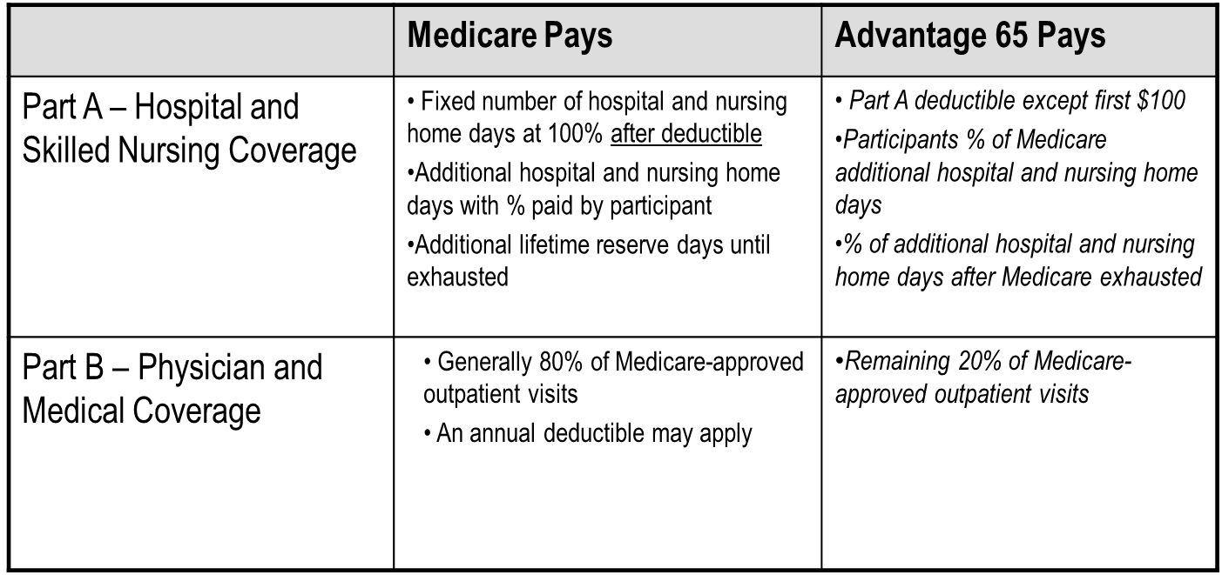
HEALTH BENEFITS

Slide 20
HEALTH BENEFITS –
PRESCRIPTION DRUG PLAN
 | Medicare | Advantage 65
Part D – Prescription Drug Coverage | Pays a benefit based on the specific Part D plan in which the beneficiary is enrolled. Generally limited by annual $ maximum unless catastrophic cost level reached. | Enhanced prescription drug plan, with no annual maximum. Annual deductible for brand-name drugs. No deductible for generics. See handout. You may elect Advantage 65 with prescription drug coverage only at retirement. You cannot later add prescription drug coverage to a Medical Only plan.

Slide 21
HEALTH BENEFITS – DENTAL/VISION OPTION
 | Medicare | Advantage 65
Dental and Vision Coverage | Generally provides no coverage for these services | Retiree Blue View vision program administered by Anthem. Retiree routine dental program administered by Anthem. Does not include coverage for prosthetic or complex restorative services. Expanded dental coverage is not available to Medicare-eligible retirees. Dental/Vision Option can be elected at retirement or added once later. Once canceled, re-enrollment is not available.

Slide 22
VRS HEALTH INSURANCE CREDIT
Available for employees who have 15 or more years of creditable state service under VRS or an ORP.
Credit is $4 for every year of creditable state service. No cap.
Credit will be offset against the premium deducted from your monthly benefit if you participate in the State Retiree Health Plan. If you participate in another plan, credit is added to your monthly benefit.
*

Slide 23
EXAMPLE 1
MONTHLY HEALTHCARE COST - SINGLE COVERAGE
Item | Cost
Medicare B premium (standard) | $174.70 ($103,000 or less income in 2022)
Advantage 65 + Dental/Vision | $330.00
VRS Health Insurance Credit (20 years of service) | ($80.00)
 | $424.70

Slide 24
EXAMPLE 2
2023 MONTHLY HEALTHCARE COST - DUAL COVERAGE
Item | Cost
Medicare B Premium | $349.40 ($258,000 joint income in 2022)
Advantage 65 + Dental/Vision (single) | $330.00
COVA Care + Expanded Dental (single) for non-Medicare spouse | $837.00
Medicare D Income Related Adjustment | $33.30 ($250,000 joint income in 2022)
VRS Health Insurance Credit (25 years) | ($100.00)
 | $1,449.70

Slide 25
IMPORTANT NOTICE ABOUT PRESCRIPTION DRUG COVERAGE FOR MEDICARE-ELIGIBLE RETIREES
If you enroll in prescription coverage more than 3 months after your 65th birthday, Anthem’s pharmacy benefit management company will send you a letter warning that you are a late enrollee and subject to penalty.
If you have been continuously enrolled in the State Health Benefits Program from your 65th birthday until your retirement, you may disregard this letter.
*

Slide 26
IMPORTANT NOTICE ABOUT PRESCRIPTION DRUG COVERAGE FOR MEDICARE-ELIGIBLE RETIREES
The warning letter will include the following statement:
“If you had continuous coverage through the Commonwealth of Virginia Health Benefits Program since your Medicare eligibility, the Commonwealth of Virginia Department of Human Resource Management will attest to your coverage, and you may disregard this notice.”

Slide 27
IMPORTANT NOTICE ABOUT PRESCRIPTION DRUG COVERAGE FOR MEDICARE-ELIGIBLE RETIREES
If you were enrolled in any plan other than the State Health Benefits Program between your 65th birthday and your retirement, you will need to provide proof that you had creditable prescription drug coverage (i.e. coverage at least as good as Medicare Part D) during that period.
Contact VCU Benefits for a “Proof of Creditable Prescription Drug Coverage” letter if required.

Slide 28
RETIREE LIFE INSURANCE
Basic Group Life Insurance - after retirement
If you are eligible for reduced or unreduced retirement when you leave your VRS-covered position, you are eligible to retain your life insurance benefit.
Natural death benefit and accelerated death benefit continue at no cost to you.
Death benefit equal to your creditable compensation at retirement, rounded to the next highest thousand and then doubled.
Your coverage begins to reduce on January 1 following one calendar year after your employment ends. The reduction rate is 25% each January 1 until it reaches 25% of the total life insurance benefit value at retirement.
*

Slide 29
LEAVE PAYMENTS
You may defer your payable leave to the Virginia Deferred Compensation Plan (DCP) or the VCU Tax-deferred annuity (TDA) if you are a participant when you retire. If you do not defer leave payment, it is automatically issued in cash as a direct deposit.
Unused accrued annual leave or university leave is payable up to the maximum allowed by policy (Faculty, University and Academic Professional, or Classified staff).
For Faculty and Classified with VSDP leave balances:
-There is no payment for Sick Leave or Personal and Family Leave.
For retirees with Disability Credits:
-You can convert disability credits to months of service (173 hours = 1 month of service). Classified employees, and University and Academic Professionals who converted from Classified at VCU, can instead be paid for 25% of disability credits up to $5,000.
For Traditional Sick Leave Plan (TSLP) balances:
-Payout for Classified employees or University and Academic Professionals who converted from Classified at VCU: Payout is 25% of your traditional sick leave balance up to $5,000.
-Payable balance can be used to purchase VRS service credit.
-Faculty and University and Academic Professionals who converted from Faculty: no payout for traditional sick leave.
*
Notes:
‹#›

Slide 30
REEMPLOYMENT OF RETIREES
Must have a break in Commonwealth of Virginia employment of at least one full calendar month (between time of retirement and new employment in a non-covered position) during a period in which you would have normally worked in the position from which you retired before returning to non-covered employment with any other state agency of the Commonwealth.
Must have a break in VCU employment of at least 26 weeks between the time of retirement and re-employment in a non-covered position at VCU.
Must not have a pre-arranged agreement to return to any Commonwealth of Virginia employment; and
Must not be hired to perform the identical job duties of the position from which you retired.
Any re-employment agreement must be for a limited term (can only be hired into an hourly or adjunct position unless you stop retirement benefit). VCU re-employment requires VP approval.
*

Slide 31
REEMPLOYMENT OF RETIREES
It’s important that retirees not be re-employed in non-covered positions with state agencies for more than 1,664 hours annually.
1,664-hour cap is imposed by IRS regulations. (IRS regulations dictate that such an employee must not work more than 80% of his/her previous full-time job. 80% of 2,080 hours = 1,664.) VCU policy limits hourly (wage) and adjunct employment to 29 hours per week or less, on average, over each May – April period.

Slide 32
PROCESS OF RETIREMENT
Determine retirement date:
-Must be the first of the month.
Apply online with VRS or complete retirement forms and submit to VCU Benefits.
Submit retiree health coverage form to VCU Benefits or enroll online in Cardinal.
Deadline reminder: for retirement application at least 60 days, but not more than four months (120 days), before your effective date of retirement. For retiree healthcare you have up to 31 days after your retirement date to enroll.
*

Slide 33
VRS RETIREMENT FORMS
Required Forms
Application for Service Retirement (VRS-5)
NEW – Online Retirement Application through myVRS
State Retiree Health Benefits Program enrollment form
NEW- Enroll and make changes through Cardinal online
Additional Optional Forms
Designation of Beneficiary (VRS-2)
NEW – Update Beneficiaries Online through myVRS
Request for Health Insurance Credit (VRS-45)
VSDP Long-Term Care Continuation Forms
*

Slide 34
PLANNING FOR RETIREMENT BENEFITS
Download a copy of the Getting Ready to Retire guide from the VRS website at www.varetire.org
Sign up on the VRS website at www.varetire.org to attend a group or individual counseling Session.
*

Slide 35
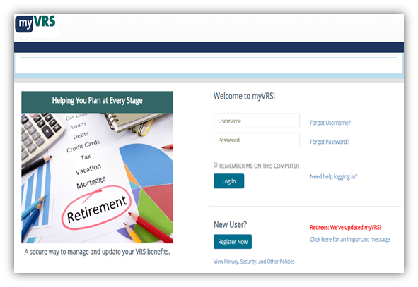
REGISTER/LOG IN TO YOUR myVRS
Register and log into myVRS.
View your member information, including service credit and compensation reported to VRS by your employer.
Check the status of an application for retirement, purchase of prior service, or refund.
Estimate your retirement benefit using current information.
View and update your personal contact information online.
View your Member Benefit Profile.
*

Slide 36
ADDITIONAL RESOURCES
State Resources
Virginia Department of Human Resource Management (DHRM)
Virginia Insurance Counseling and Assistance Program (VICAP)
Virginia Center on Aging
Other Agencies
AARP
IRS
Continued Learning
LifeLong Learning Institute
Senior Citizens Higher Education Program

Slide 37
QUESTIONS?
CONTACT INFORMATION:
HR Support ticket: https://go.vcu.edu/hrsupport
BENEFITS TEAM CONTACT
BENEFITSHELP@VCU.EDU
804-827-1723
Schedule a Retirement Consultation: http://bit.ly/3Cepja0

